Slide 1
Search_Animations COMP9414 23t2
Dr Armin Chitizadeh

Slide 2
Iterative Deepening Search
Tries to combine the benefits of depth-first (low memory) and breadth-first (optimal and complete)
Does a series of depth-limited depth-first searches to depth 1, 2, 3, etc.
Early states will be expanded multiple times, but that might not matter too much because most of the nodes are near the leaves.
Dr Armin Chitizadeh

Slide 3




Iterative Deepening Search
Dr Armin Chitizadeh

Slide 4




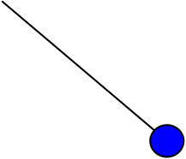



Iterative Deepening Search
Dr Armin Chitizadeh

Slide 5





Iterative Deepening Search
Dr Armin Chitizadeh

Slide 6
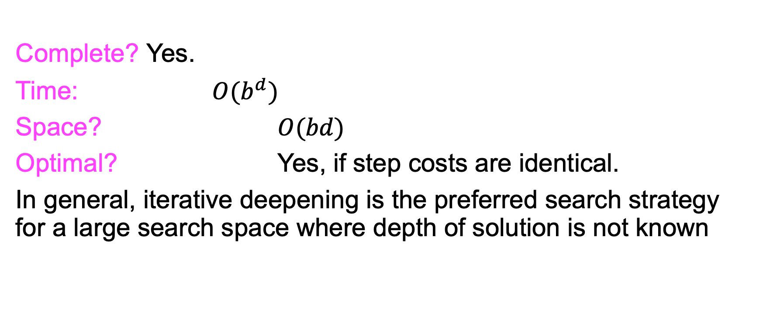
Properties of Iterative Deepening Search
Complete? Yes.
Time: $O(b^{d})$
Space? $O(bd)$
Optimal? Yes, if step costs are identical.
In general, iterative deepening is the preferred search strategy for a large search space where depth of solution is not known
Dr Armin Chitizadeh

Slide 7
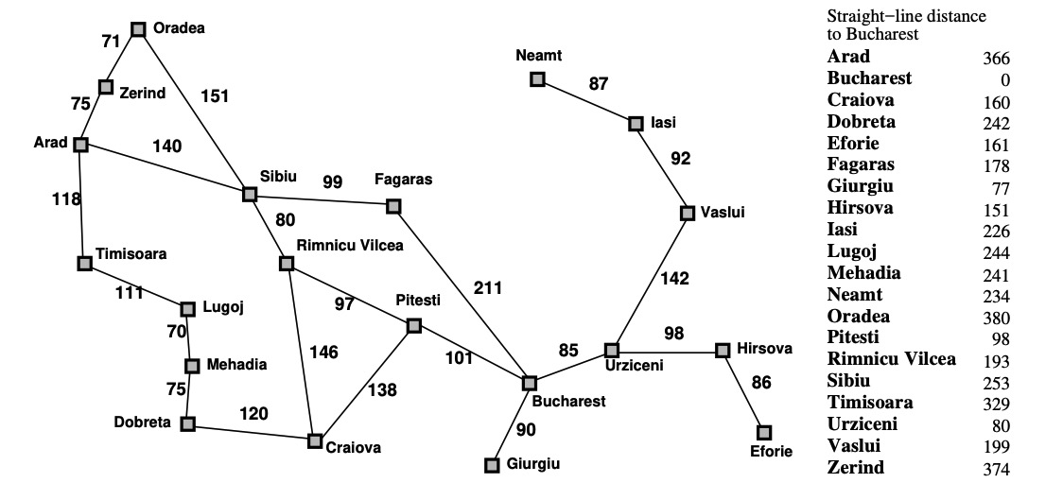
Exercise
This exercise uses the route-finding example with the Romanian map from Russell & Norvig
(Artificial Intelligence: A Modern Approach) as an example.
For the route from Arad to Bucharest, what order are nodes in the state space expanded for each of the following algorithms when searching for the shortest path between Arad and Bucharest? Where there is a choice of nodes take the first one by alphabetical ordering. For depth-first search use cycle checking along a path to avoid repeated states that may lead to infinite branches. Stop the search when the goal state is expanded.
* Iterative Deepening Depth First Search

Slide 8
Exercise IDDFS d=1
A
Dr Armin Chitizadeh

Slide 9
Exercise IDDFS d=2
A
S
T
Z
Dr Armin Chitizadeh

Slide 10
Exercise IDDFS d=3
A
S
T
Z
F
R
O
L
O
A S O
A Z O
Dr Armin Chitizadeh

Slide 11
Exercise IDDFS d=4
A
S
T
Z
F
R
O
B
Dr Armin Chitizadeh

